Slide 1

SHOW
ME DATA
队伍：只吃一碗饭
Speaker:
Feng Yunjia
Team Members:
Li Xinhao
Ding Jianqiao
Feng Yunjia

Slide 2
Contents:
1. Background
2. Functionality
3. Tech-route
4. Future Plan

Slide 3
Chapter.1 Background

Slide 4

Black Swan:
COVID-19

Slide 5

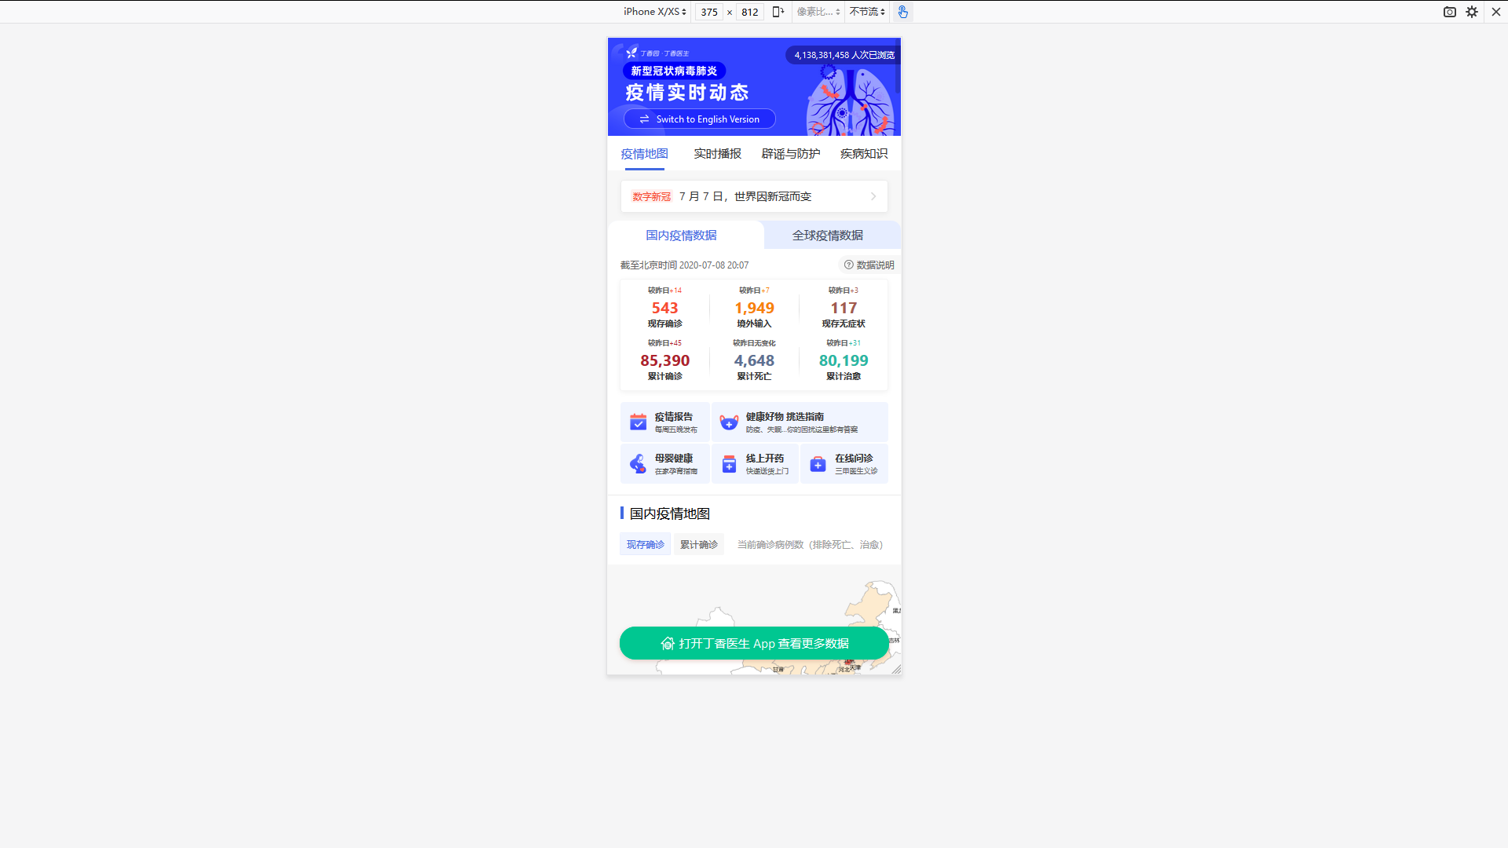
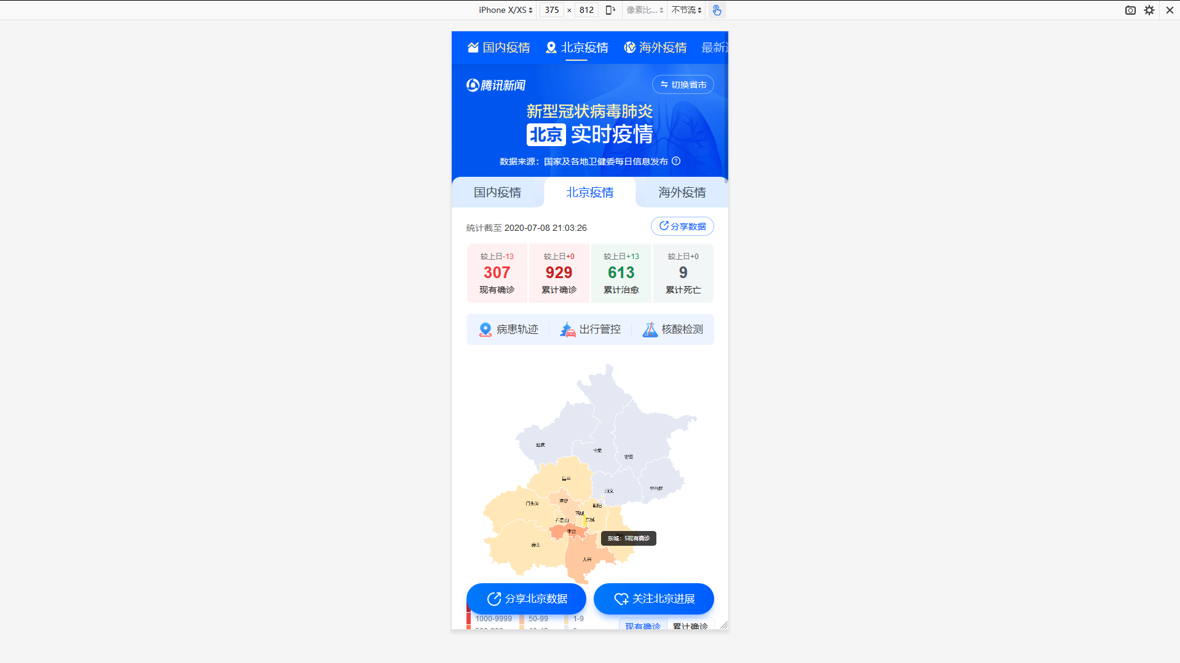
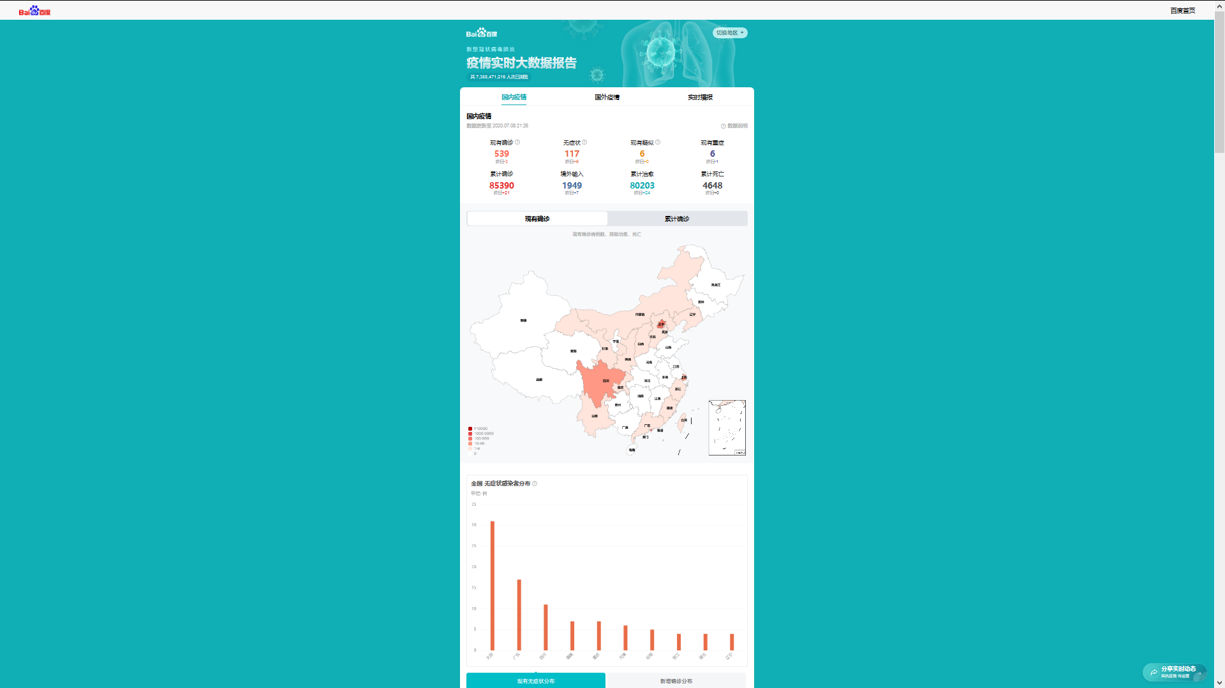
Tencent
Ding Xiang Yuan
Baidu

Slide 6
Chapter.2 Functionality

Slide 7
Functionality
Epidemic Review
Review About How This Virus Happened
Consensus Analysis
Epidemic Alert
Analysis About How Consensus Is Going on In This Epidemic
Giving Warning To
Avoid Getting Infected
SHOW
ME
DATA
Live Data
Virus Prevention
Showing Live Data Collected From The Internet
Some Heath Habits
To Avoid COVID-19

Slide 8
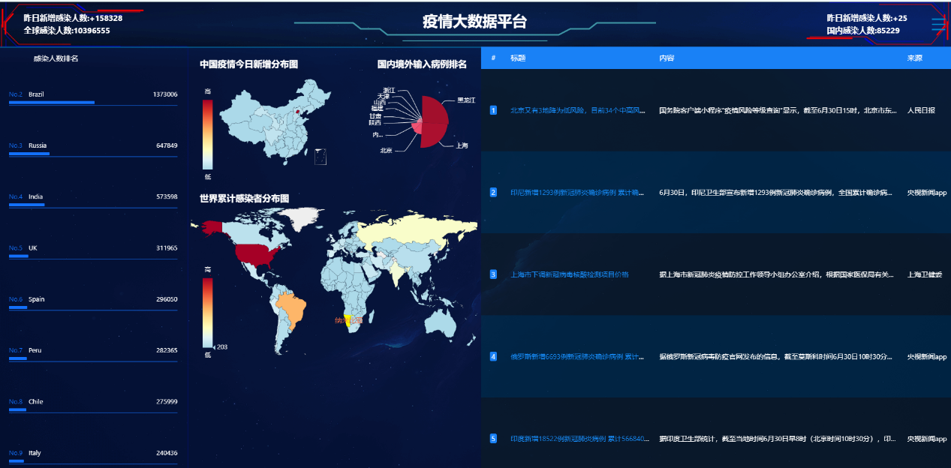
Live Data

Slide 9
Infected Number
America
Russia
UK
French
China

Slide 10
China’s Daily Increase
China’s
Input
from Overseas
World’s Infected

Slide 11
Live News Collected From The Internet

Slide 12
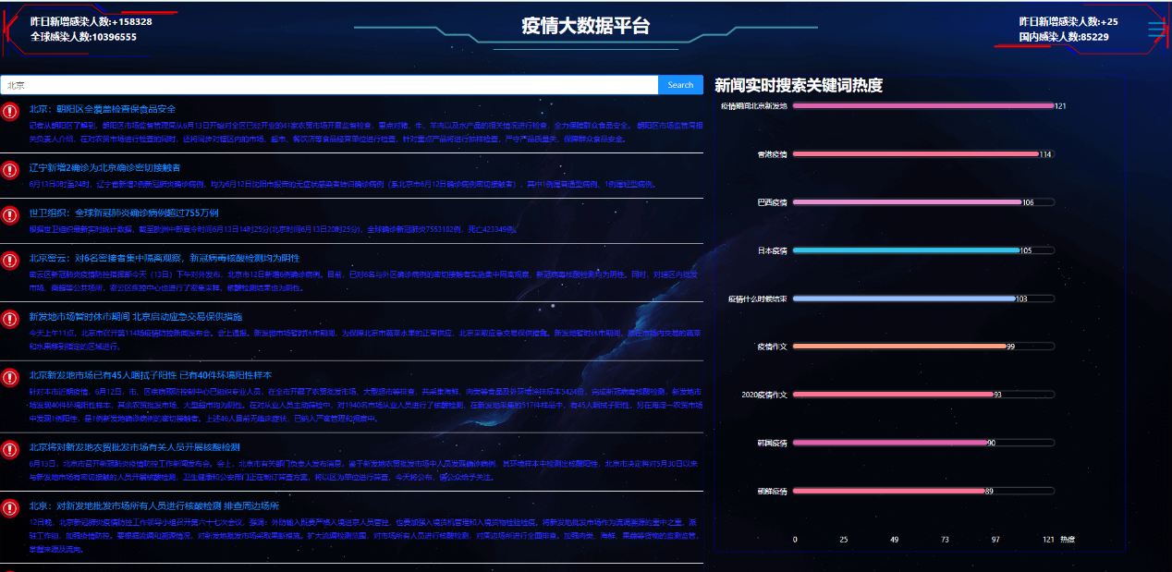
Consensus Analysis

Slide 13
News Selecting

Slide 14
Rumor Collecting
Heat of News

Slide 15
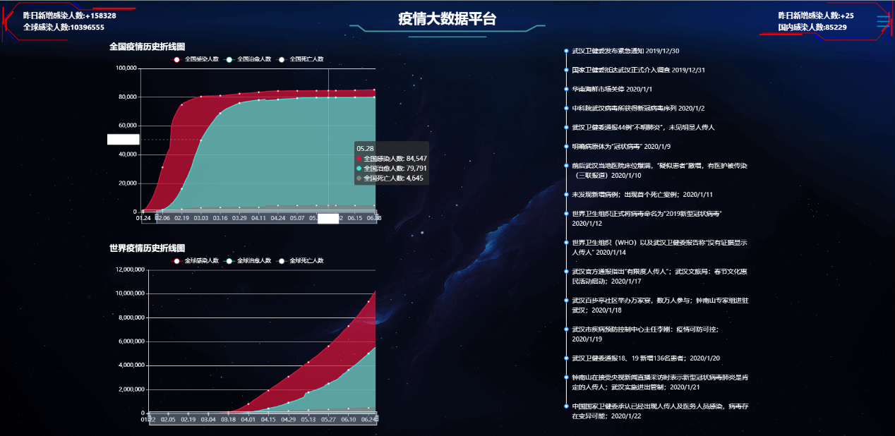
Epidemic Review

Slide 16
View History Data

Slide 17
View History Events

Slide 18
View History Events

Slide 19
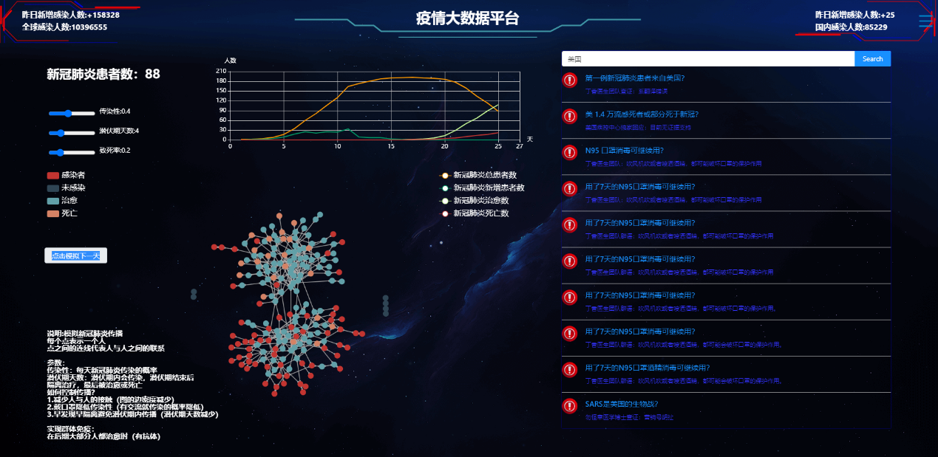
Epidemic Alert

Slide 20
Epidemic Simulation

Slide 21
Rumor Collecting

Slide 22
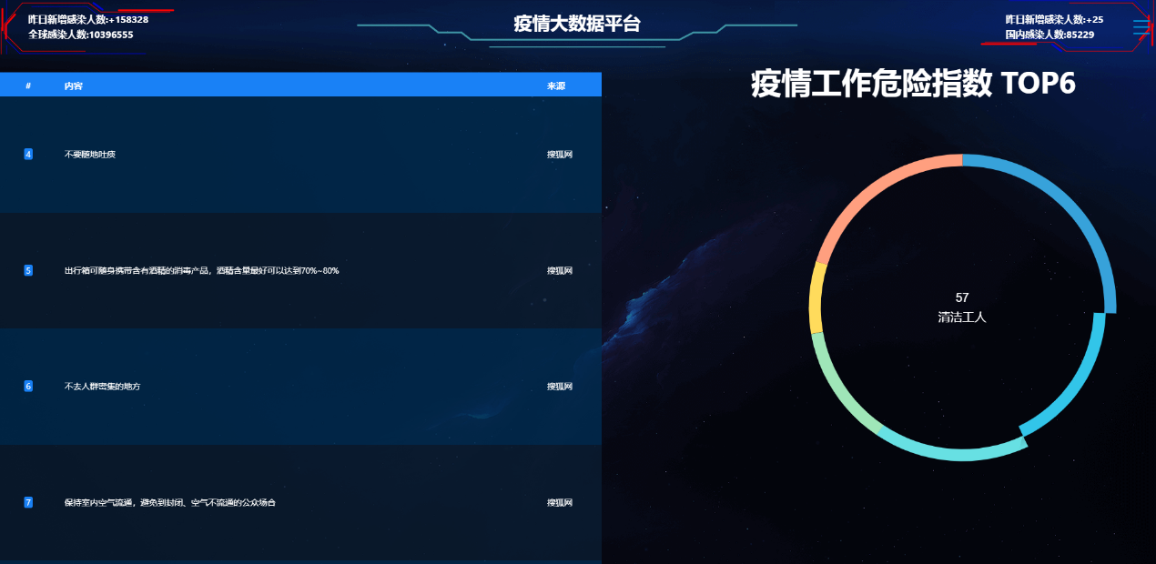
Epidemic Review

Slide 23
Methods
Against
COVID-19

Slide 24
Top “Dangerous” Jobs

Slide 25
Chapter.3 Tech-Route

Slide 27
Express Layer
Logic Layer
Data Layer

Slide 28




DataV
Echarts.js
Express Layer
Vue.js
Ant Design

Slide 29

Logic Layer

Slide 30

Data Layer

Slide 31
Chapter.4 Future Plan

Slide 32
Cloud Deployment

Slide 33
More Platforms

Slide 34
Better Design

Slide 35
Thank You
LIKE

